Slide 1
Wireless Security
Information Security

Slide 2
Wireless Security
Wireless Security
  Wireless Network
  Wireless Attacks: Bluetooth
  IEEE 802.11 Wireless Standard
  Wireless Network Modes
  Wireless Security Overview
  Wireless Networking Components
  Wireless LAN Attacks
  Six Modes of Wireless NICs
  Securing Wireless Networks

Slide 3
Wireless Security
Wireless Networks
Wireless networks always have been targets for attackers
  Early wireless networking standards had vulnerabilities
  Hackers have found wireless networks relatively easy to break into, and even use wireless technology to crack into wired networks.
Notes:
https://www.mathsisfun.com/physics/waves-radio-microwave.html

Slide 4
Wireless Security
Wireless Attacks: Bluetooth
Bluetooth
  Wireless technology
  Uses short-range radio frequency transmissions
  Provides for rapid, ad-hoc device pairings
    Example: smartphone and Bluetooth headphones
  Personal Area Network (PAN) technology
Two types of Bluetooth network topologies
  Piconet
  Scatternet

Slide 5
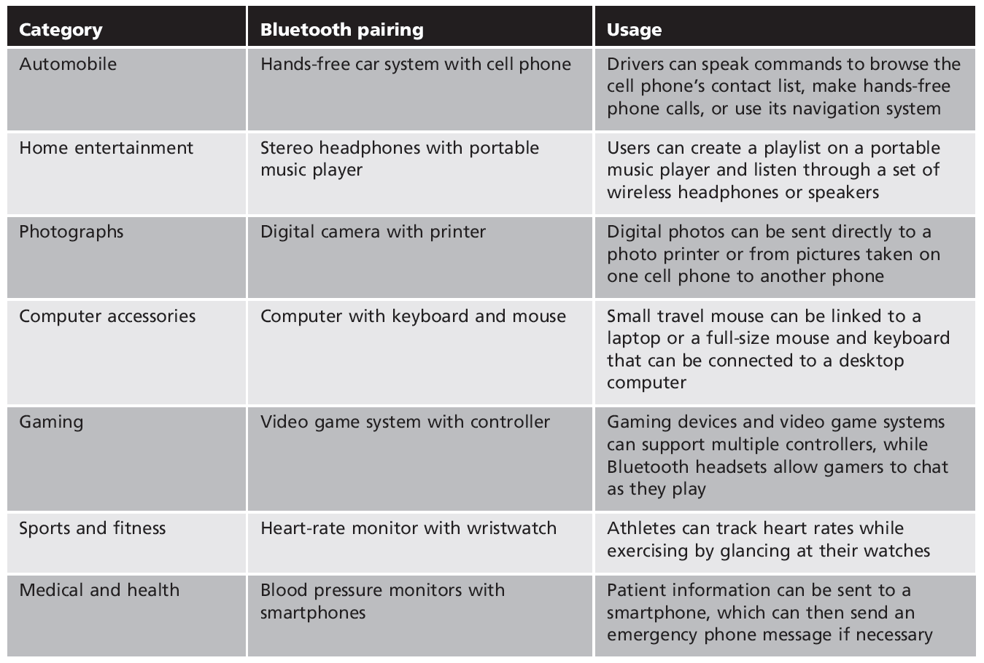
Wireless Security
Bluetooth
Products

Slide 6
Wireless Security
Wireless Attacks: Bluetooth
Piconet
  Established when two Bluetooth devices come within range of each other
  One device (master) controls all wireless traffic
  Other device (slave) takes commands
    Active slaves can send transmissions
    Parked slaves are connected but not actively participating

Slide 7
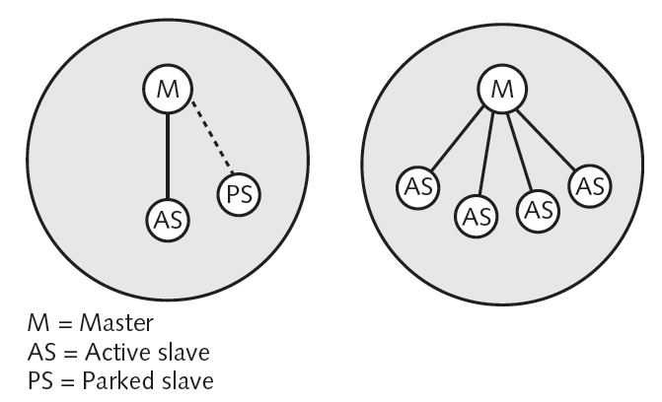
Wireless Security
Wireless Attacks: Bluetooth
Piconet

Slide 8
Wireless Security
Wireless Attacks: Bluetooth
Scatternet
  Group of piconets with connections between different piconets
Bluejacking
  Attack that sends unrequested messages to Bluetooth-enabled devices
    Text messages, images, or sounds
  Considered more irritating than harmful
    No data is stolen
Notes:
Unsolicited: unrequested

Slide 9
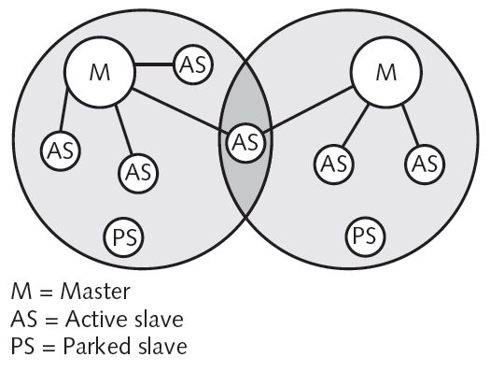
Wireless Security
Wireless Attacks: Bluetooth
Scatternet

Slide 10
Wireless Security
Wireless Attacks: Bluetooth
Bluesnarfing
  Unauthorized access to wireless information through a Bluetooth connection
  Often between cell phones and laptops
  Attacker copies e-mails, contacts, or other data by connecting to the Bluetooth device without owner’s knowledge

Slide 11
Wireless Security
IEEE 802.11 Wireless Standard
IEEE 802: a committee responsible for LANs
IEEE 802.11: responsible for developing wireless protocols
  Many standards
The Wi-Fi alliance: became popular with 802.11b
  Wi-Fi Protected Access (WPA, WPA2)
Notes:
Wi-Fi(wireless fidelity.) Fidelity is the quality of faithfulness or loyalty.
Wi-Fi Protected Access is a security mechanism based on IEEE 802.11
Wi-Fi Protected Access (WPA), Wi-Fi Protected Access 2 (WPA2), and Wi-Fi Protected Access 3 (WPA3)

Slide 12
Wireless Security
IEEE 802.11 Wireless Standard
Institute of Electrical and Electronics Engineers (IEEE)
  Most influential organization for computer networking and wireless communications
  Began developing network architecture standards in the 1980s
1997: Release of IEEE 802.11
  Standard for wireless local area networks (WLANs)
  Higher speeds added in 1999: IEEE 802.11b

Slide 13
Wireless Security
IEEE 802.11 Wireless Standard
IEEE 802.11a
  Specifies maximum rated speed of 54Mbps using the 5GHz spectrum
IEEE 802.11g
  Preserves stable and widely accepted features of 802.11b
  Increases data transfer rates similar to 802.11a
IEEE 802.11n
  Approve in 2009
Notes:
https://en.wikipedia.org/wiki/IEEE_802.11n-2009

Slide 14
Wireless Security
IEEE 802.11 Wireless Standard
Improvements in IEEE 802.11n
  Speed
  Coverage area
  Interference
  Security
Wireless client network interface card adapter
  Performs same functions as wired adapter
  Antenna sends and receives signals
Notes:
Wi-Fi interference is any signal outside of the configured Wi-Fi network that weaken normal operation of the Wi-Fi network

Slide 15
Wireless Security
Wireless Network Modes
The 802.11 wireless networks operate in two basic modes:
  Infrastructure mode
  Ad-hoc mode
Infrastructure mode
  Each wireless client connects directly to a central device called Access Point (AP)
  No direct connection between wireless clients
  AP acts as a wireless hub that performs the connections and handles them between wireless clients
Notes:
ad hoc network is a type of wireless local area network (WLAN) that enables devices to connect with others without the need for access points (APs)

Slide 16
Wireless Security
Wireless Network Modes
Ad-hoc mode
  Each wireless client connects directly with each other
  No central device managing the connections
  Rapid deployment of a network where no infrastructures exist (advantage in case of disaster…)
  Each node must maintain its proper authentication list

Slide 17
Wireless Security
Wireless Security Overview
Concerns for wireless security are similar to those found in a wired environment
Security requirements are the same:
  Confidentiality, integrity, availability, authenticity, accountability
  Most significant source of risk is the underlying communications medium

Slide 18
Wireless Security
Wireless Security Overview: Key Risks Factors
Channel: broadcast communication (more sensitive to eavesdropping and jamming)
Mobility: Additional risks
Resources: Advanced OS (iPhone, Android), but limited resources (memory, processing)
Accessibility: Certain devices may be left unattended

Slide 19
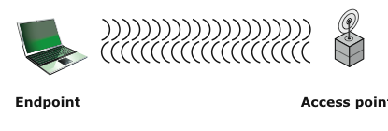
Wireless Security
Wireless Networking Components (Facilitating points of attacks)
Wireless client: WIFI-enabled laptop/tablet, cell phone, Bluetooth device, …
Access point: Cell towers, WIFI hotspots, wireless routers
Transmission medium: carries signals

Slide 20
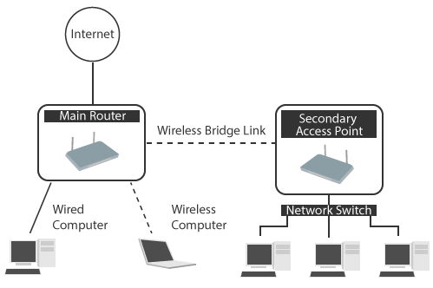
Wireless Security
Wireless Networking Components
Access point (AP) major parts
  Antenna and radio transmitter/receiver send and receive wireless signals
  Bridging software to interface wireless devices to other devices
  Wired network interface allows it to connect by cable to standard wired networks

Slide 21
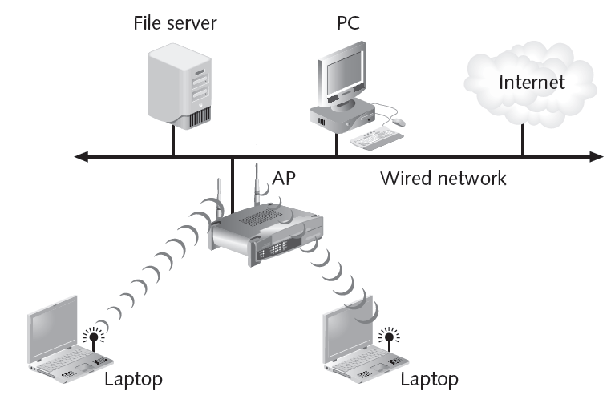
Wireless Security
Wireless Networking Components

Slide 22
Wireless Security
Wireless Networking Components
AP functions
  Acts as “base station” for wireless network
  Acts as a bridge between wireless and wired networks
    Can connect to wired network by a cable
  Instead of running cable between the two buildings, which is more expensive, two outdoor access points have been configured for wireless mesh.

Slide 23
Wireless Security
Wireless Networking Components
Autonomous access points
  All APs were Autonomous mode, which means that each AP worked as a standalone unit with no knowledge of or interaction among other APs.
  APs are connected to the same network, and may use the same SSID, they are all individually configured and separate from one another.
  Have necessary “intelligence” for wireless authentication, encryption, and management
Notes:
SSID stands for Service Set Identifier
The SSID (Service Set Identifier) is the name of your wireless network, also known as Network ID. This is viewable to anyone with a wireless device within reachable distance of your network.

Slide 24
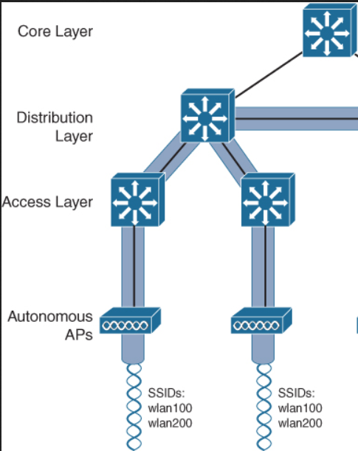
Wireless Security
Wireless Networking Components
Autonomous access points
Notes:
SSID stands for Service Set Identifier
The SSID (Service Set Identifier) is the name of your wireless network, also known as Network ID. This is viewable to anyone with a wireless device within reachable distance of your network.

Slide 25
Wireless Security
Wireless Networking Components
Lightweight access points
  Rather than using Autonomous mode APs, you can use Lightweight mode APs if you have a network component that offers Wireless LAN Controller services.
Wireless broadband routers
  Single hardware device containing AP, firewall, router, and DHCP server
Notes:
lightweight access point:
there are a couple of protocols that you might run into … that are used to communicate … between the wireless LAN controller and the APs. … The first protocol is LWAPP. … That stands for Lightweight Access Point Protocol. … However, that's an older protocol, … it's becoming less popular in favor of CAPWAP. … That stands for Control and Provisioning … of Wireless Access Points. …

Slide 26
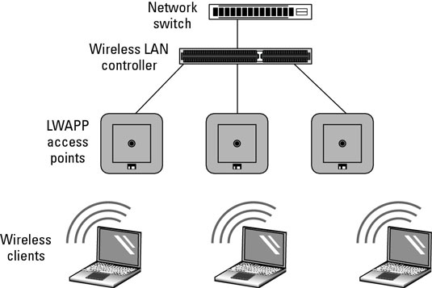
Wireless Security
Wireless Networking Components
Notes:
lightweight access point:
there are a couple of protocols that you might run into … that are used to communicate … between the wireless LAN controller and the APs. … The first protocol is LWAPP. … That stands for Lightweight Access Point Protocol. … However, that's an older protocol, … it's becoming less popular in favor of CAPWA
CAPWAP (Control and Provisioning of Wireless Access Points) is a protocol that enables an access controller to manage a collection of wireless termination points.P. … That stands for Control and Provisioning … of Wireless Access Points. …

